Slide 1
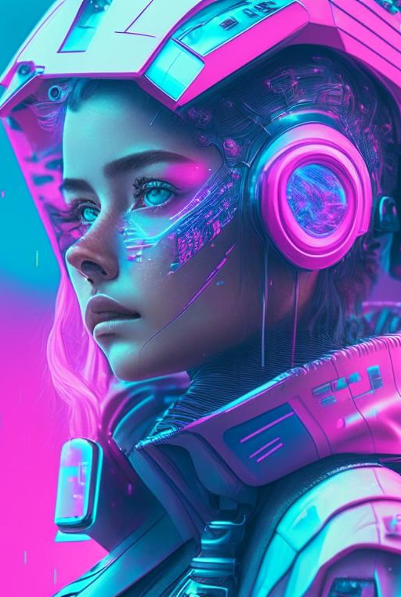
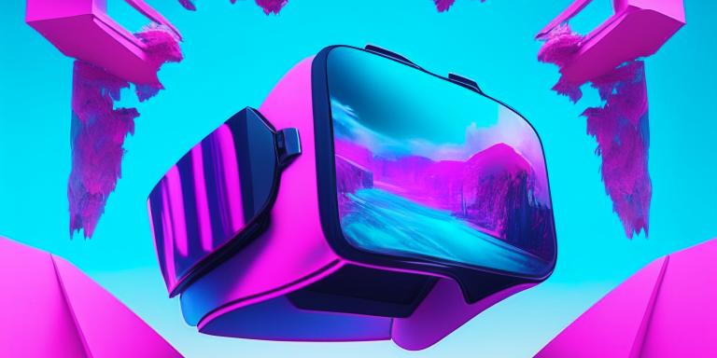
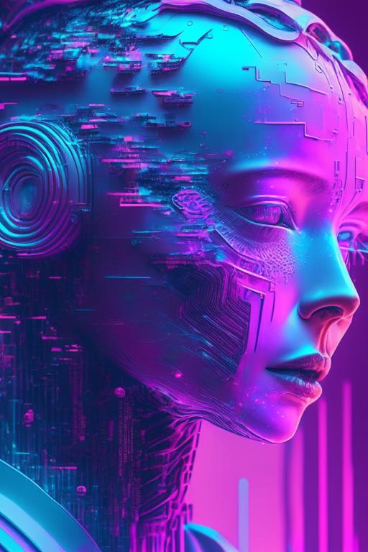
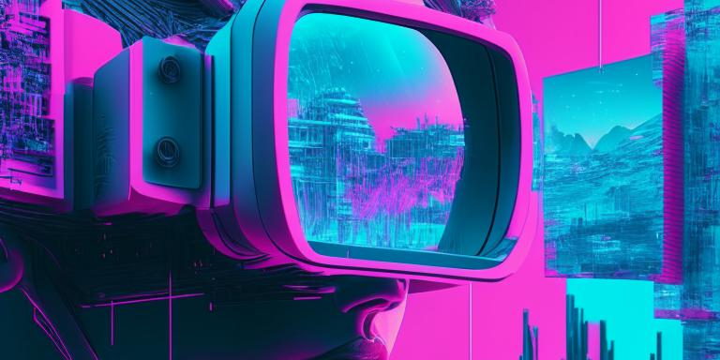

Webinar ChatGPT for HR
Acceleration, simplification, and optimization of HR work through neural network technologies
Read by: Vladislav Botnev
AI, ChatGPT, Prompt, HR

Slide 2
Webinar Agenda
On the agenda today
What is ChatGPT
Interface of ChatGPT
5 use-cases
Prompts
Other applications
We’ll delve a little into what generative neural networks are, how they are created, and how they work
We’ll explore how to use the web interface of ChatGPT
We’ll examine how an HR specialist can use ChatGPT through the example of 5 use-cases
We'll learn what a prompt is and how to improve ChatGPT's response
We'll briefly discuss non-work-related applications of ChatGPT, its analogues, as well as neural networks for image generation.

Slide 3
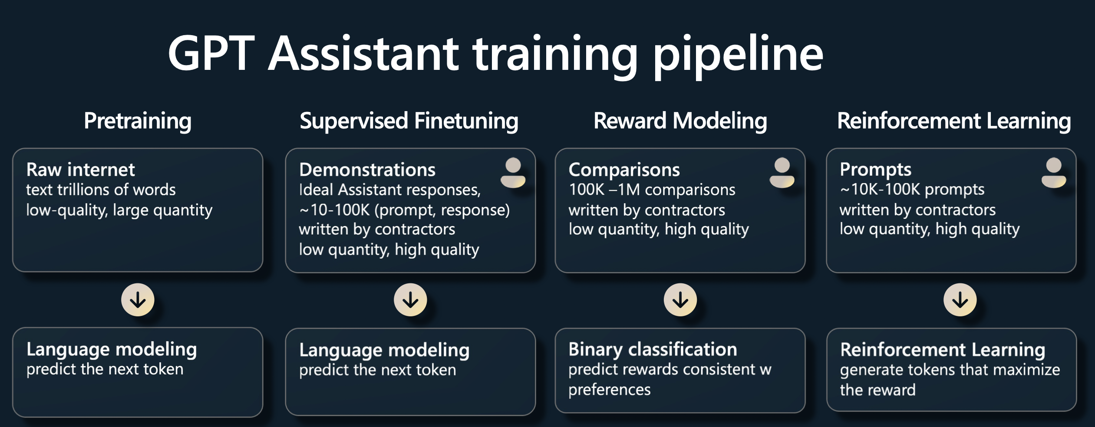
Introduction to ChatGPT and the GPT model
How neural networks are created
Source: https://karpathy.ai/stateofgpt.pdf

Slide 4
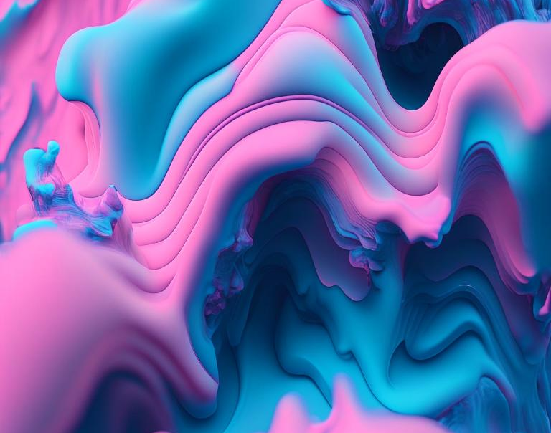
ChatGPT and HR: Why is it beneficial?
ChatGPT expedites and simplifies HR processes.
AI in HR:
Recruitment and personnel selection
Onboarding new employees
Performance management
Training and development
Conflict management and problem-solving
Termination process management
Presentation creation
Interview preparation.

Slide 5
Use-cases for today's webinar
1
2
3
Email templates
Resume analysis
Job vacancy creation
4
5
Presentation creation
interview preparation for unique positions
In today's webinar, we will explore the use cases of ChatGPT in a professional environment, email templates, resume analysis, job vacancy creation, presentation development, and interview preparation for unique positions. Valuable tips and skills will be presented to help streamline the workflow.

Slide 6
Email templates

Slide 7
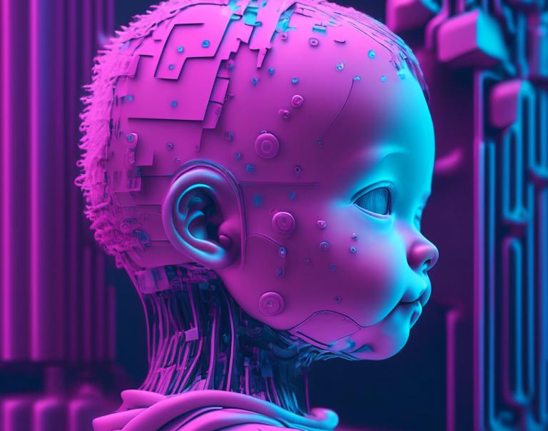
How to improve prompts?
Prompt - a query within the chat, a hint.
Role models (Write a template, act as an HR).
Fine-tuning (Write a template + Job description).

Slide 8
Job vacancy creation
Resume analysis

Slide 9
interview preparation

Slide 10
Presentation creation

Slide 11
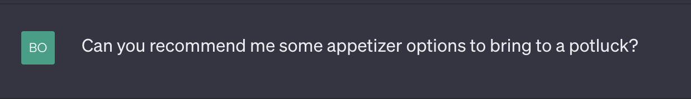
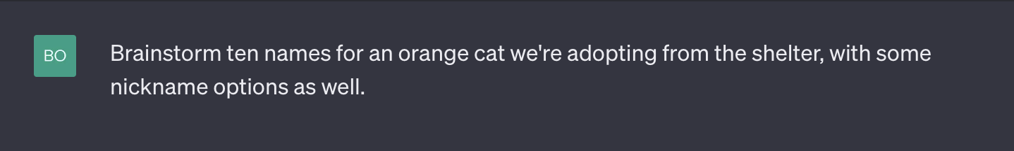
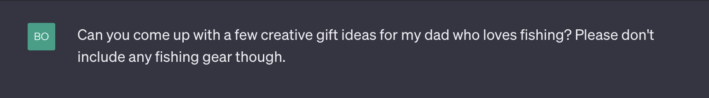
A little off-topic
ChatGPT can be used to solve everyday tasks

Slide 12
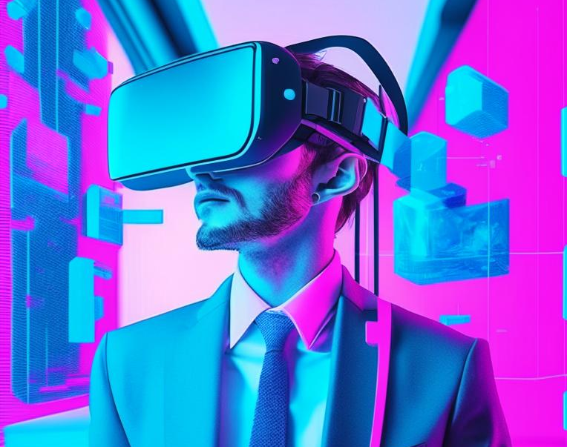
Overview of other neural networks
Text generation
ChatGPT(Open AI)
Claude(Antropic)
Bard(Google)
Image generation
Stable diffusion
MidJourney
DALL-E 2
Kandinsky
Introduce an IT company employee in a pink and blue color scheme. The company specializes in digitalization, AI, virtual reality, and computer vision

